Slide 1
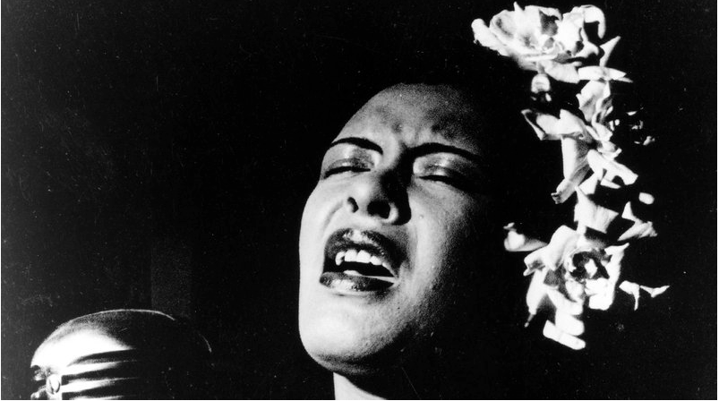
The Haunting of Billie Holiday
Warning Advisory: Graphic Images

Slide 2
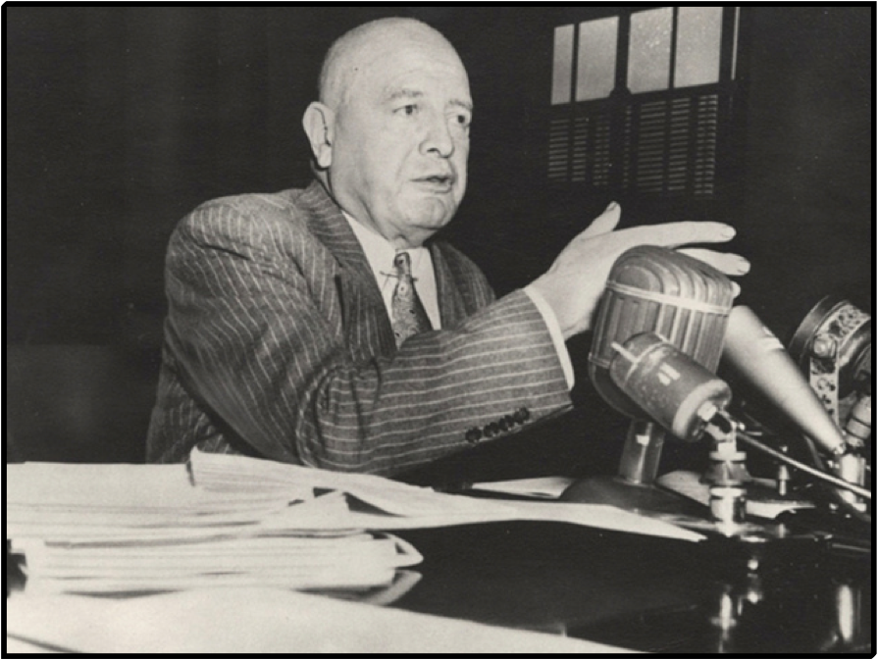
“[Jazz] sounded like the jungles in the dead of night. The lives of jazzmen reek of filth.”
Harry Anslinger | Director | Federal Bureau of Narcotics

Slide 3
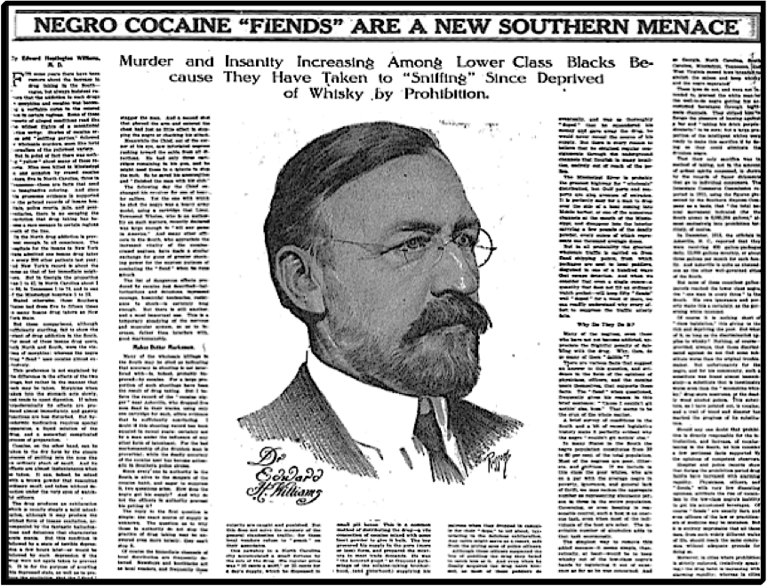
New York Times, circa 1914

Slide 4
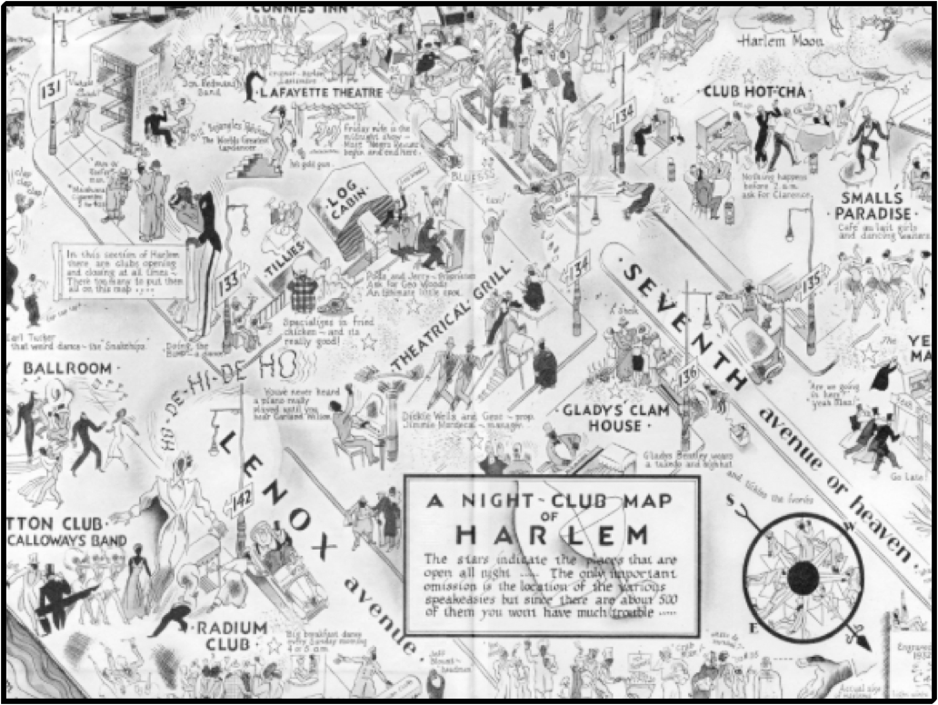

Slide 5
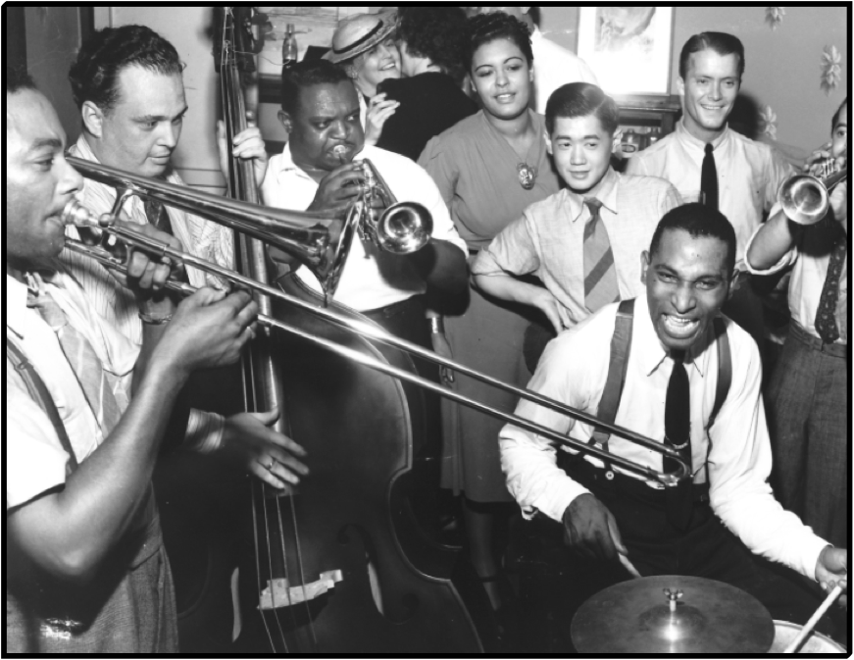

Slide 6
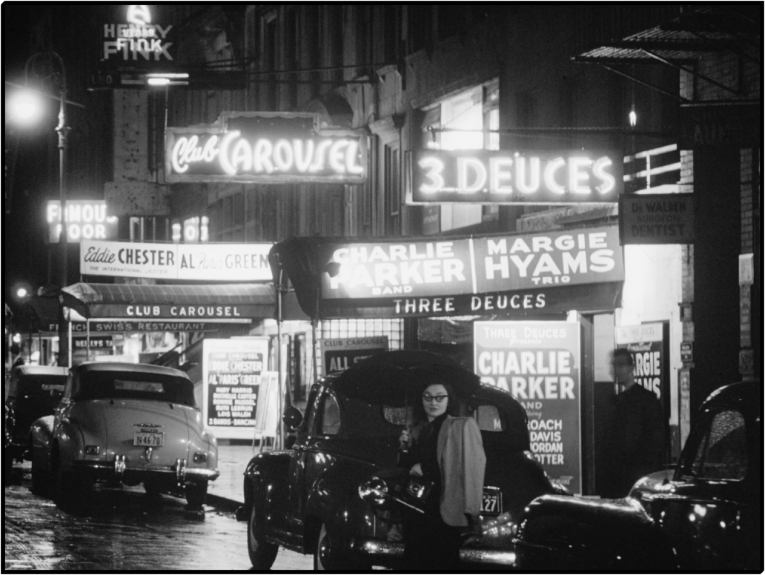

Slide 7
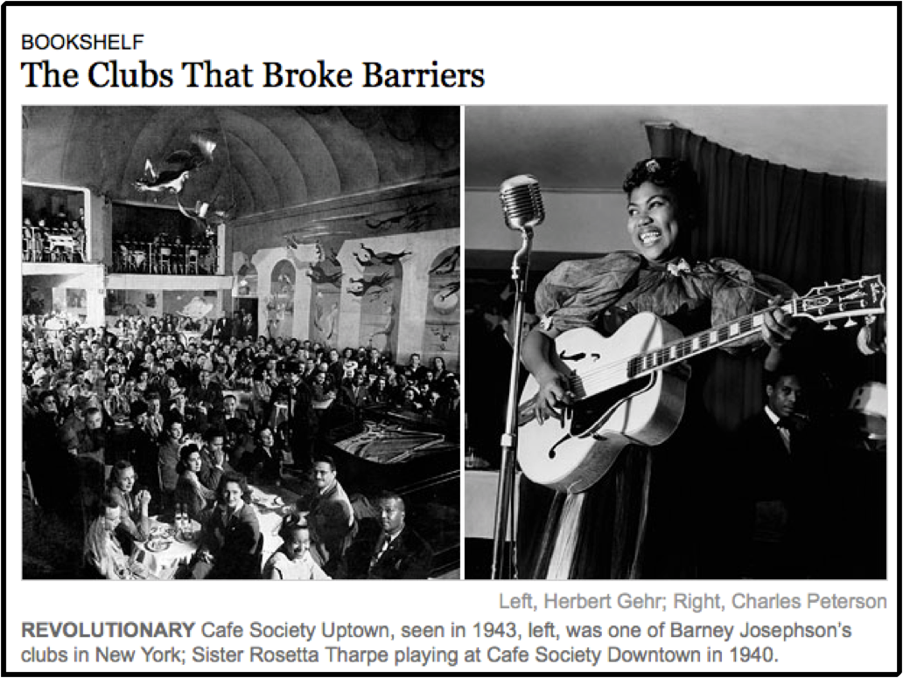

Slide 8
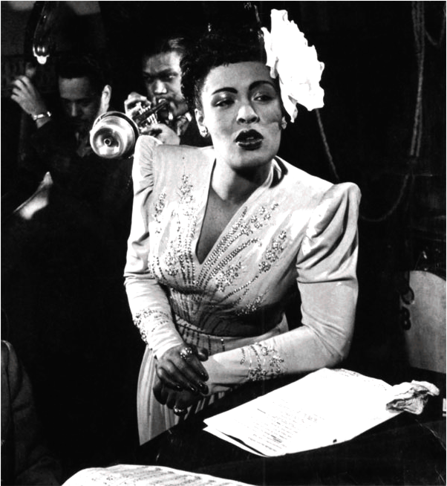

Slide 9
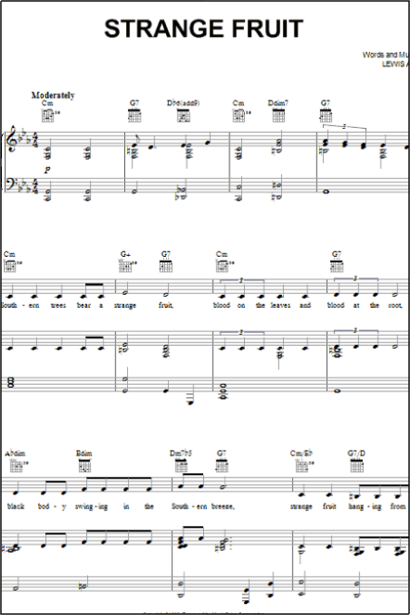
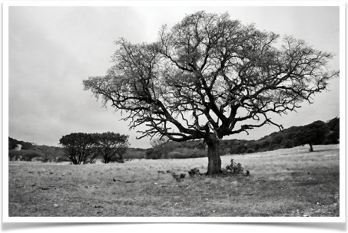
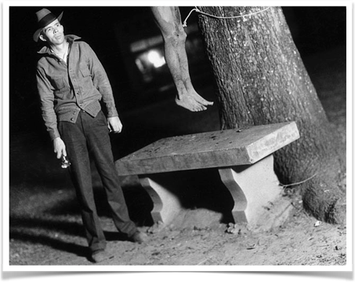

Slide 10
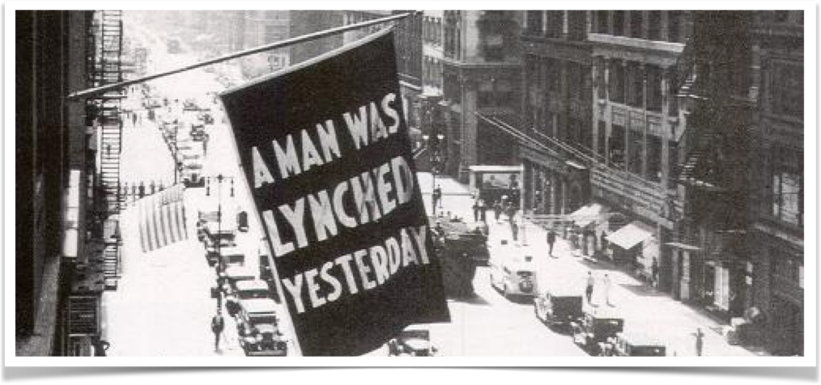

Slide 11
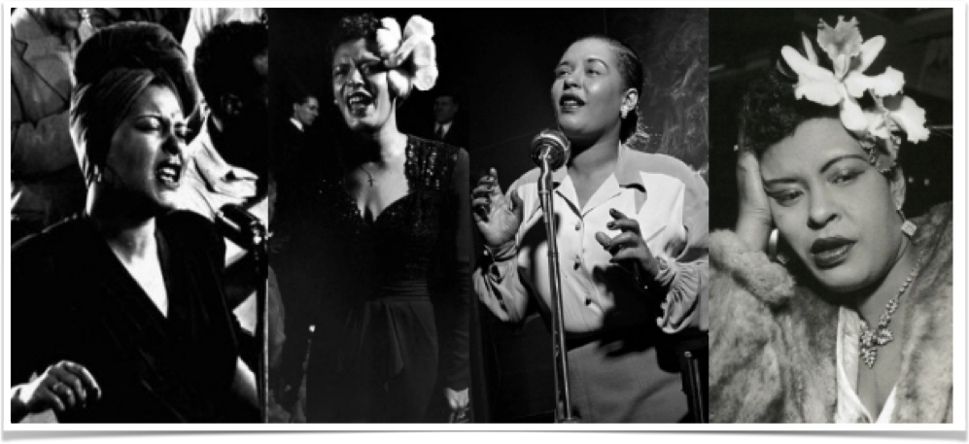

Slide 12
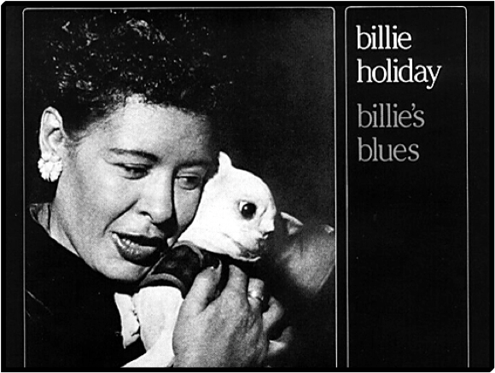
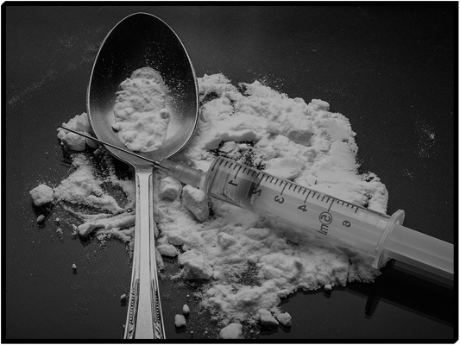
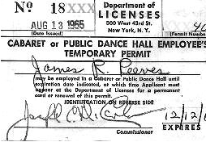
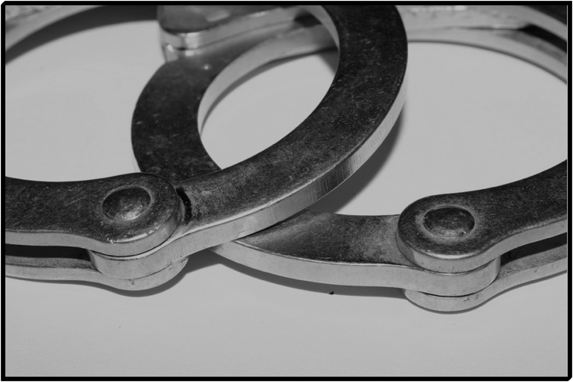

REVOKED

Slide 13
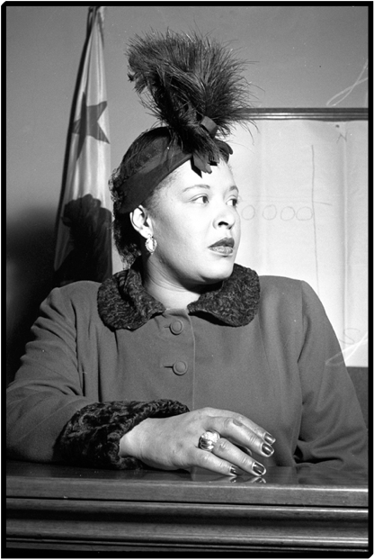
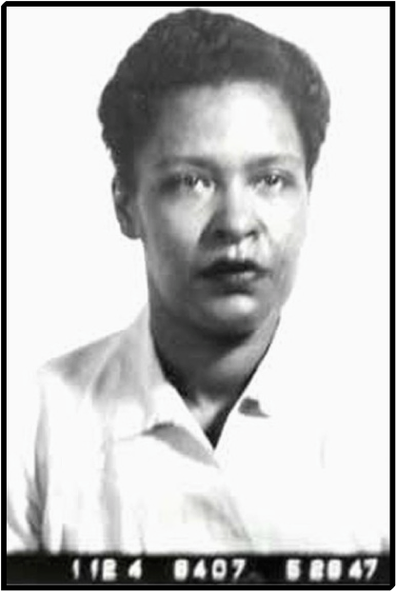
The United States of America versus Billie Holiday

Slide 14
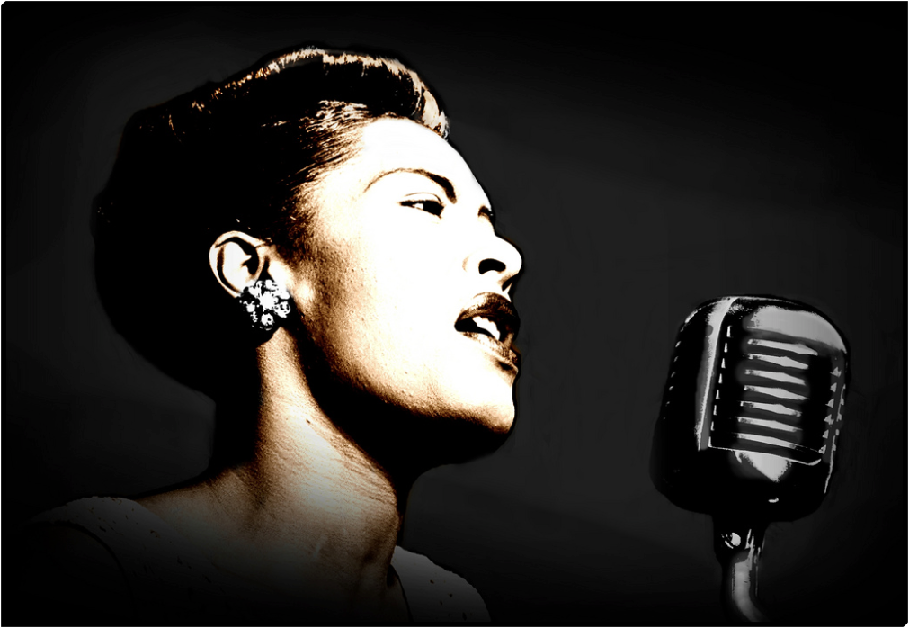

Slide 15
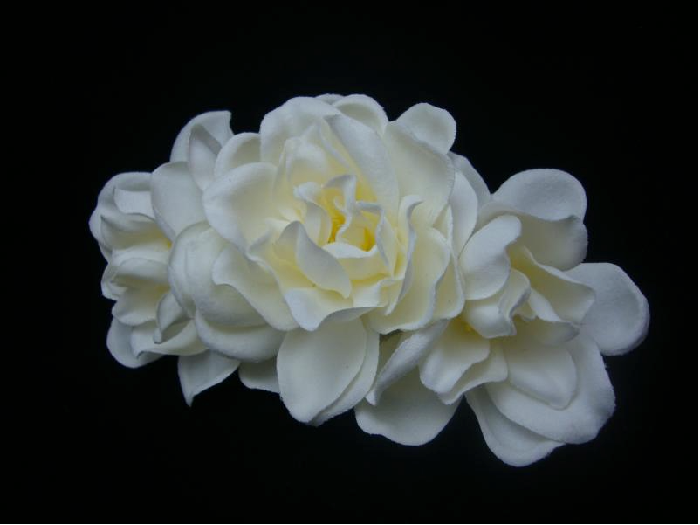

Slide 16
Photo Credits
Slide 1: cafleurebon.com
Slide 2: Special Collections Library, Pennsylvania State University
Slide 3: The New York Times | nytimes.com
Slide 4: Elmer Simms Campbell | boningboing.net
Slide 5: jazzinphoto
Slide 6: William Gottlieb, Library of Congress
Slide 7: The New York Times | nytimes.com
Slide 8: silhouettetrends.com | radiopereira.it
Slide 9A (sheet music): sheetmusicdirect.us
Slide 9B (Branchy Tree): Lynda Giddens
Slide 9C (hanging): aspoonfulofsugar.wordpress.com
Slide 10: nachalooman.wordpress.com
Slide 11: silhouettetrends.com
Slide 12A (album cover w/dog): becuo.com
Slide 12B (heroin works): livescience.com
Slide 12C (handcuffs): The Aiken Standard |aikenstandard.com
Slide 12D (liquor): Chris Huh | wikipedia.com
Slide 12E (cabaret card): snip view.com
Slide 13A (trial): Los Angeles Daily News
Slide 13B (mugshot): Federal Bureau of Prisons
Slide 14: Lammyman, 2010 | flickr.com
Slide 15: hairflowers.net

