Slide 1
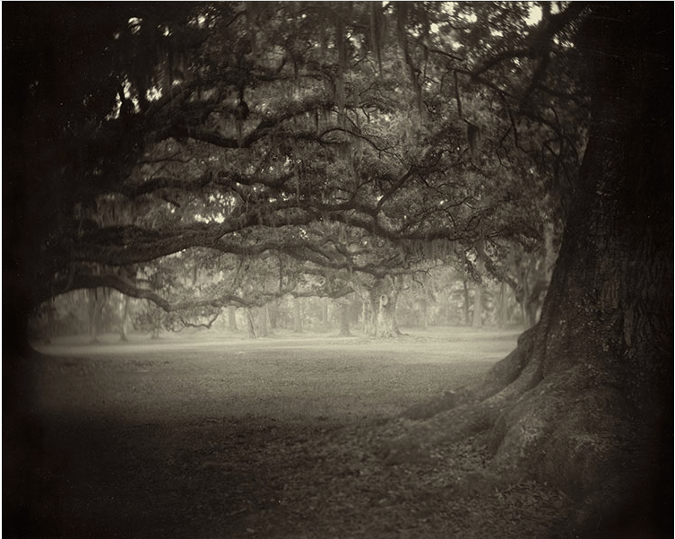
By Norma Martin | EMAC 6374 | Spring 2015
A Haunting Song
The Originality of Author;
The Authenticity of Narrative

Slide 2
What Does It Matter Who Is Speaking?
Foucault, M., What is an Author?

Slide 3
The Author’s Story
Form, Plot, Structure
Character, Description, Dialogue
Engagement, Interactive, Participation
Conflict, Crisis, Resolution

Slide 4
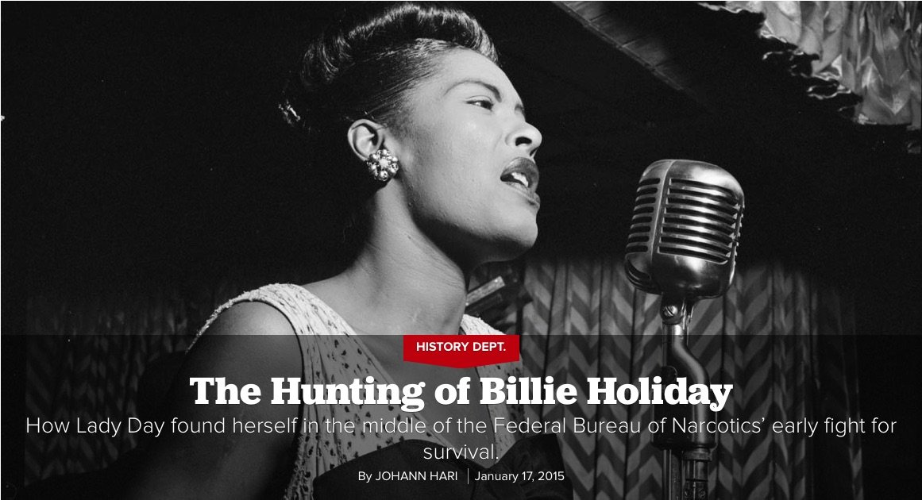

Slide 5
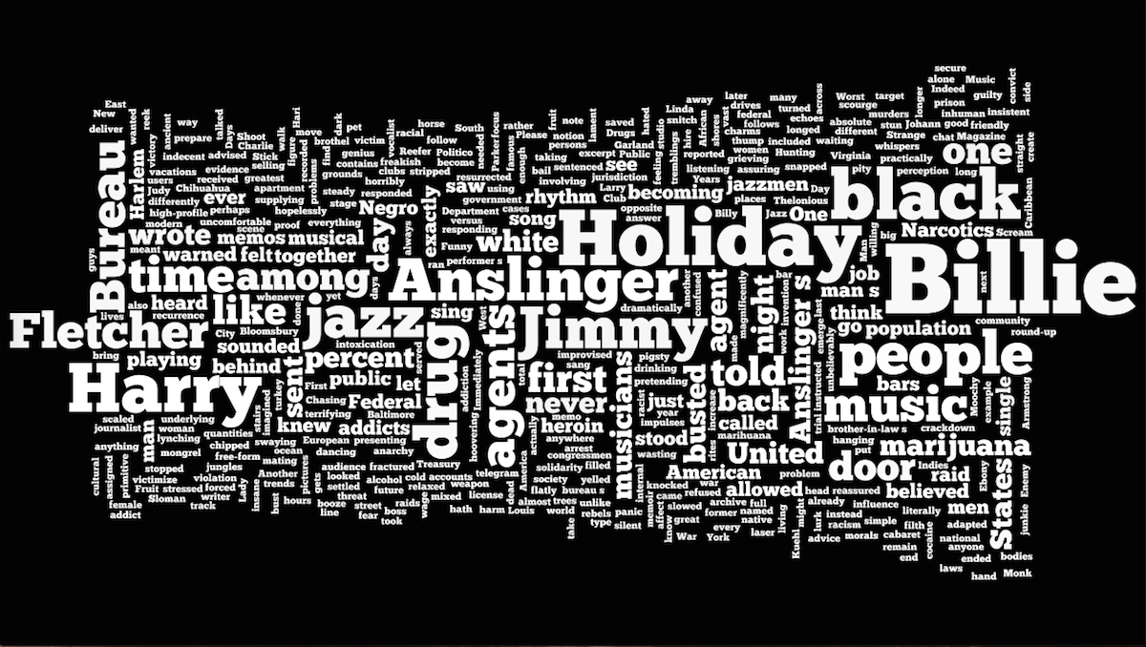
Notes:
900 words. The original text. The intricate detail (a complicated story). The shape of the image (a woman’s body). The white words; the black background (racism in America).

Slide 6
Narrative Elements
Jazz music.
Negro.
Gardenias.
Lady Day.
Narcotics.
Heroin addiction.
Celebrity.
Harlem nightclubs.
Café Society
Caucasian
Federal agents.
Arrest.
Jim Crow.
Criminal trials.
Prison.
Southern trees.
Lynching.
Strange Fruit
Music and lyrics.
Racial segregation.

Slide 7
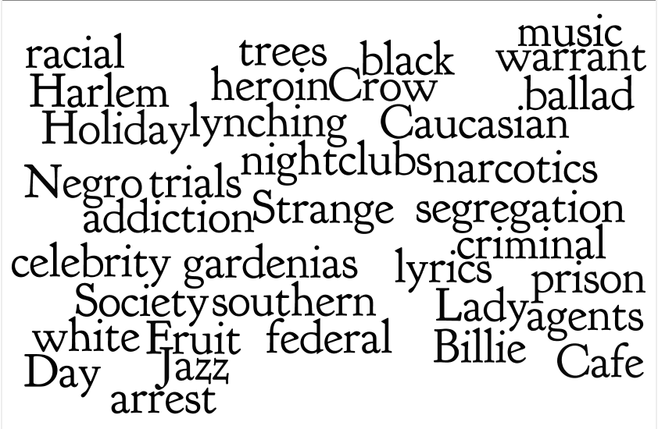

Slide 8
The Experience
Authenticity of Narrative
Notes:
Not the written words of the originality of the author. Not the author’s form, structure or plot. Authenticity of the narrative is the experience the audience has with the story.

Slide 9

Evocative. Cinematic. Sensuous.

Slide 10
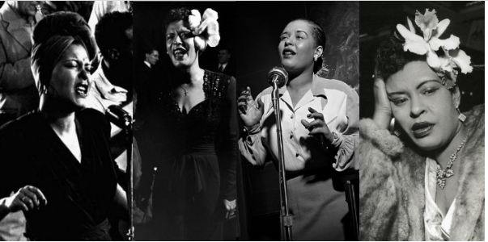
The Character

Slide 11
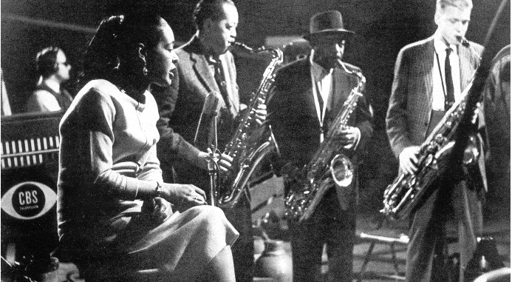
The Scene

Slide 12
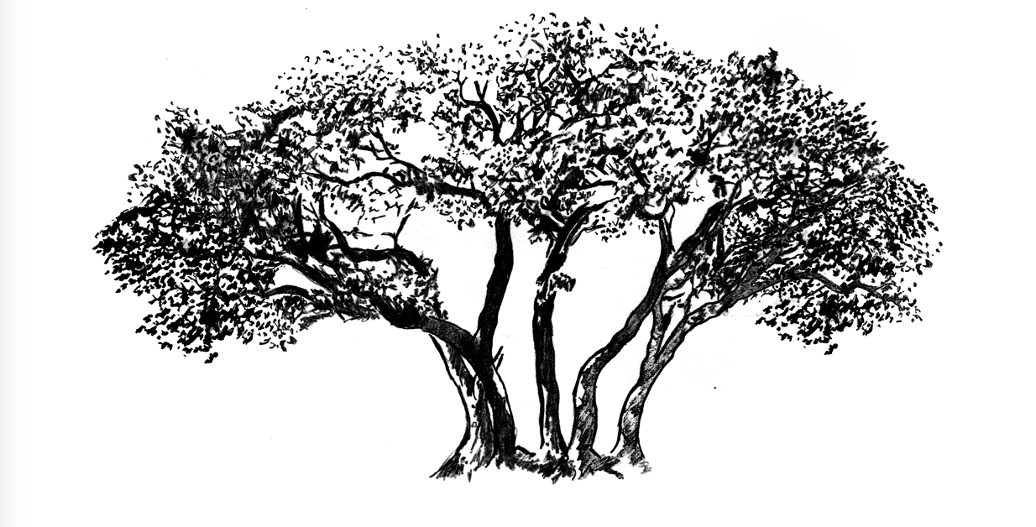
The Song

Slide 13
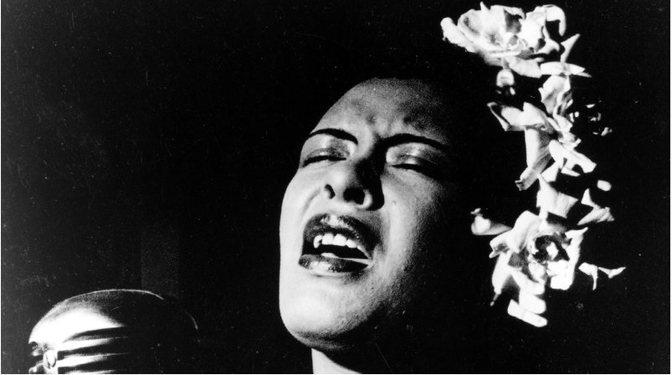
The Haunting of Billie Holiday

Slide 14
Media Credits
Slide 1. Southern Landscape: Sally Mann, alexisclementsphotography.com
Slide 4. Holiday in Bow Dress: William P. Gottlieb/Ira and Leonore S. Gershwin Fund Collection, Music Division, Library of Congress
Slide 8. Five Senses: progressiverenweal.org
Slide 9. Holiday in Collage: silhouettetrends.com
Slide 10. Holiday with Sax Players: jimmywinokur.com
Slide 11. Tree in Drawing: martiens.deviantart.com
Slide 12: Gardenia in Hair: cafleurebon.com
Music: Strange Fruit by Billie Holiday (1956 version)

